Slide 1

Week 2: The Bag ADT
CS/COE 0445 - Data Structures
Sherif Khattab
http://www.cs.pitt.edu/~skhattab/cs0445
(Some slide contents are © 2016 Pearson Education, Ltd. All rights reserved.
Others are from Dr. Ramirez’s CS 445 course)

Slide 2
Administrivia
Assignment 1 is up and due on Monday Jan. 29 @11:59pm.
Prepare for the lab by going over the pre-lab part

Slide 3
Earlier in the course
Java interfaces and generics

Slide 4
Today’s Topic
The Bag ADT

Slide 5
ADT Bag
The Bag
Think of a real bag in which we can place things
No rule about how many items to put in
No rule about the order of the items
No rule about duplicate items
No rule about what type of items to put in
However, we will make it homogeneous by requiring the items to be the same class or subclass of a specific Java type
Let’s look at the interface
See BagInterface.java

Slide 6
ADT Bag
Note what is NOT in the interface:
Any specification of the data for the collection
We will leave this to the implementation
The interface specifies the behaviors only
However, the implementation is at least partially implied
Must be some type of collection
Any implementation of the methods
Note that other things are not explicitly in the interface but maybe should be
Ex: What the method should do
Ex: How special cases should be handled
We typically have to handle these via comments

Slide 7
ADT Bag
Ex: public boolean add(T newEntry)
We want to consider specifications from two points of view:
What is the purpose / effect of the operation in the normal case?
What unusual / erroneous situations can occur and how do we handle them?
The first point can be handled via preconditions and postconditions
Preconditions indicate what is assumed to be the state of the ADT prior to the method's execution
Postconditions indicate what is the state of the ADT after the method's execution
From the two we can infer the method's effect

Slide 8
ADT Bag
Ex: for add(newEntry) we might have:
Precondition:
Bag is in a valid state containing N items
Postconditions:
Bag is in a valid state containing N+1 items
newEntry is now contained in the Bag
This is somewhat mathematical, so many ADTs also have operation descriptions explaining the operation in plainer terms
More complex operations may also have more complex conditions
However, pre and postconditions can be very important for verifying correctness of methods

Slide 9
ADT Bag
The second point (abnormal cases) is often trickier to handle
Sometimes the unusual / erroneous circumstances are not obvious
Often they can be handled in more than one way
Ex: for add(newEntry) we might have
Bag is not valid to begin with due to a previous error
newEntry is not a valid object
Assuming we detect the problem, we could handle it by
Doing a "no op"
Returning a false boolean value
Throwing an exception
We need to make these clear to the user of the ADT so he/she knows what to expect

Slide 10
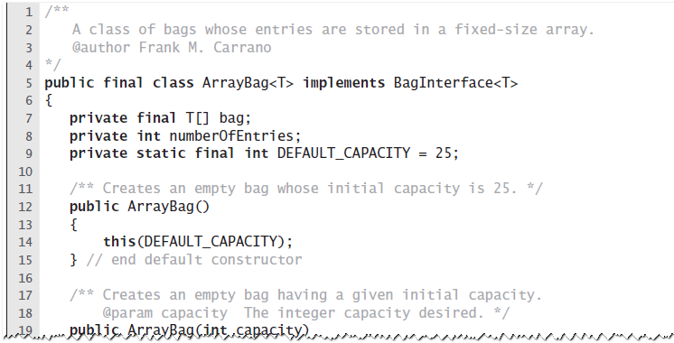
Fixed-Size Array
An outline of the class ArrayBag
© 2016 Pearson Education, Ltd. All rights reserved.

Slide 11
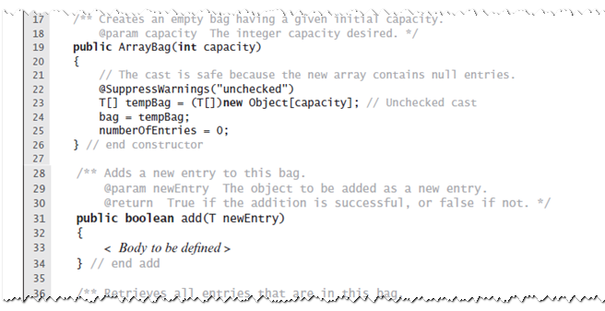
Fixed-Size Array
An outline of the class ArrayBag
© 2016 Pearson Education, Ltd. All rights reserved.

Slide 12
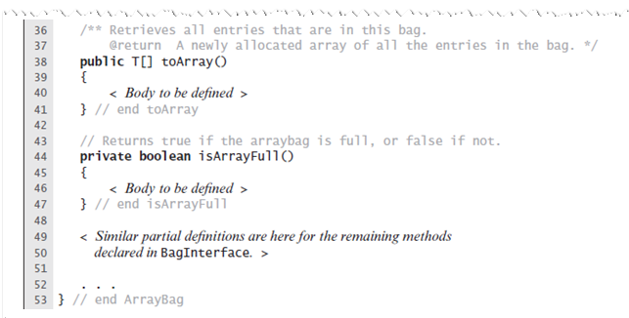
Fixed-Size Array
An outline of the class ArrayBag
© 2016 Pearson Education, Ltd. All rights reserved.

Slide 13
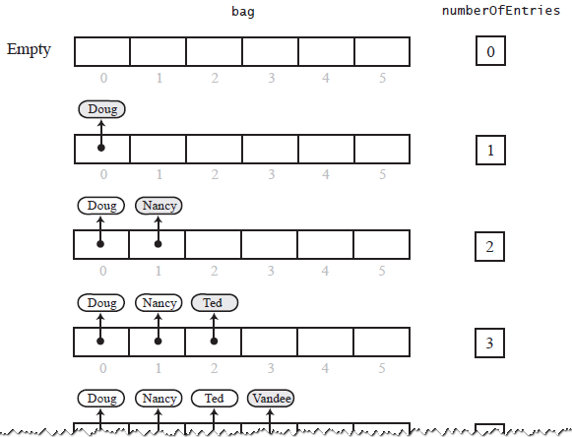
Fixed-Size Array
Adding entries to an array that represents a bag, whose capacity is six, until it becomes full
© 2016 Pearson Education, Ltd. All rights reserved.

Slide 14
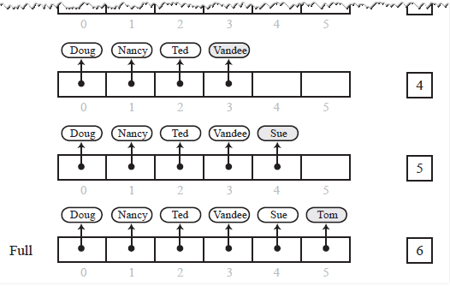
Fixed-Size Array
Adding entries to an array that represents a bag, whose capacity is six, until it becomes full
© 2016 Pearson Education, Ltd. All rights reserved.

Slide 15
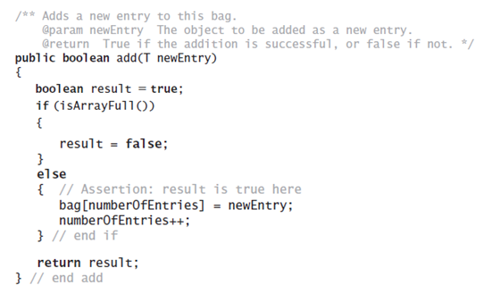
Fixed-Size Array
Method add
© 2016 Pearson Education, Ltd. All rights reserved.

Slide 16
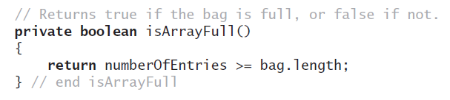
Fixed-Size Array
Method isArrayFull
© 2016 Pearson Education, Ltd. All rights reserved.

Slide 17
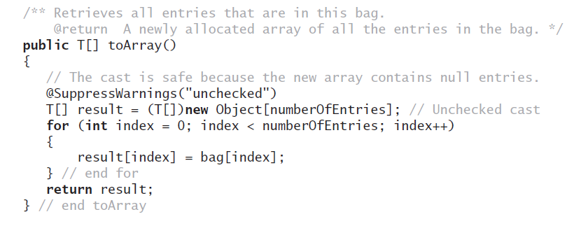
Fixed-Size Array
Method toArray
© 2016 Pearson Education, Ltd. All rights reserved.

Slide 18

Making the Implementation Secure
Practice fail-safe programming by including checks for anticipated errors
Validate input data and arguments to a method
Refine incomplete implementation of ArrayBag to make code more secure by adding the following two data fields
© 2016 Pearson Education, Ltd. All rights reserved.

Slide 19
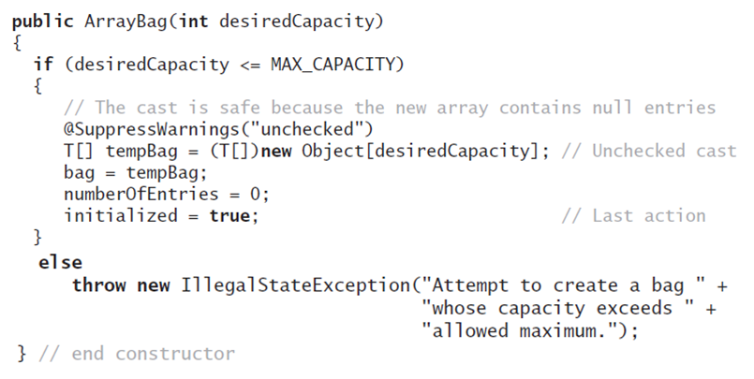
Making the Implementation Secure
Revised constructor
© 2016 Pearson Education, Ltd. All rights reserved.

Slide 20
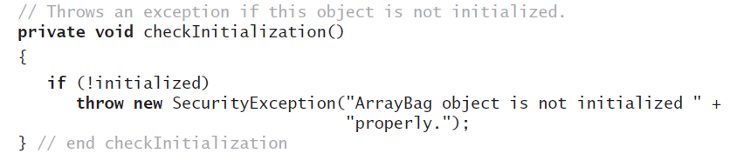
Making the Implementation Secure
Method to check initialization
© 2016 Pearson Education, Ltd. All rights reserved.

Slide 21
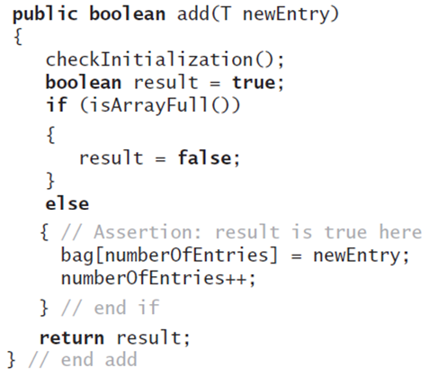
Making the Implementation Secure
Revise the method add
© 2016 Pearson Education, Ltd. All rights reserved.

Slide 22
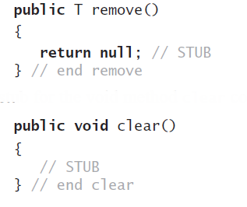
Testing the Core Methods
Stubs for remove and clear
© 2016 Pearson Education, Ltd. All rights reserved.

Slide 23
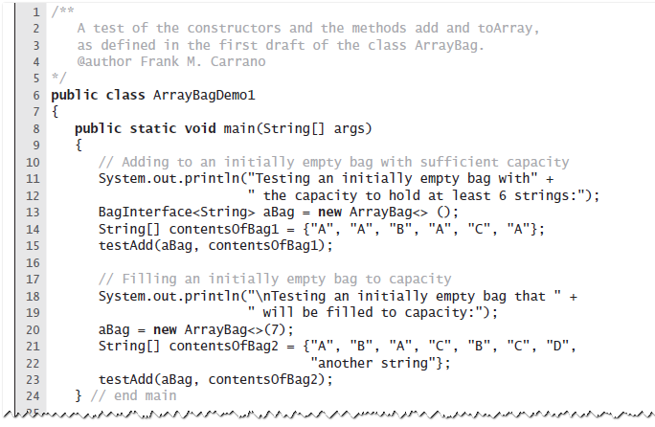
Testing the Core Methods
A program that tests core methods of the class ArrayBag
© 2016 Pearson Education, Ltd. All rights reserved.

Slide 24
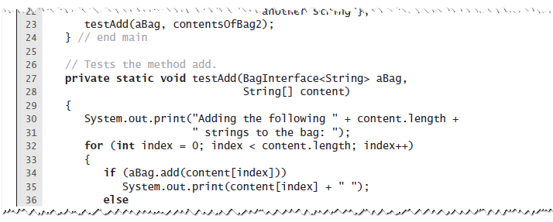
Testing the Core Methods
A program that tests core methods of the class ArrayBag
© 2016 Pearson Education, Ltd. All rights reserved.

Slide 25
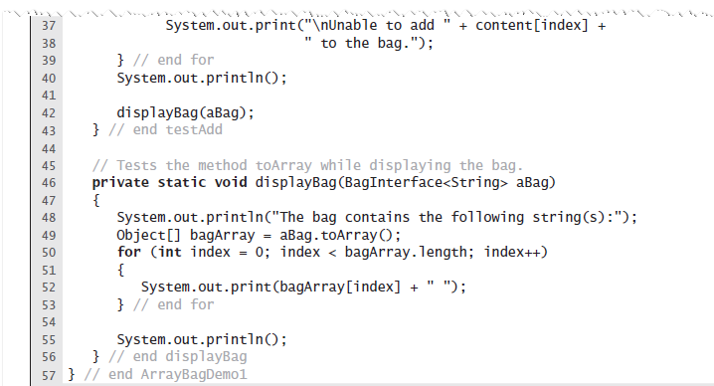
Testing the Core Methods
A program that tests core methods of the class ArrayBag
© 2016 Pearson Education, Ltd. All rights reserved.

Slide 26
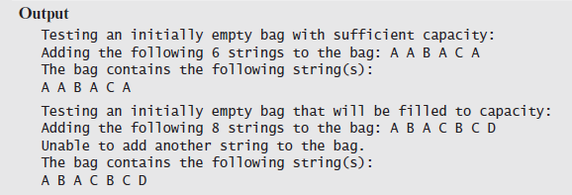
Testing the Core Methods
A program that tests core methods of the class ArrayBag
© 2016 Pearson Education, Ltd. All rights reserved.

Slide 27
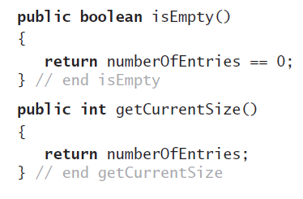
Implementing More Methods
Methods isEmpty and getCurrentSize
© 2016 Pearson Education, Ltd. All rights reserved.

Slide 28
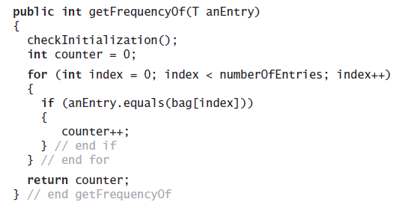
Implementing More Methods
Method getFrequencyOf
© 2016 Pearson Education, Ltd. All rights reserved.

Slide 29
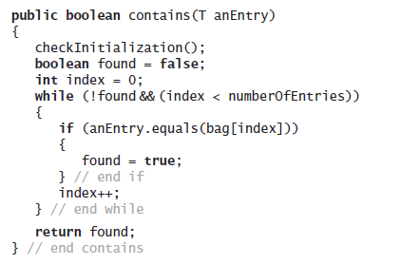
Implementing More Methods
Method contains
© 2016 Pearson Education, Ltd. All rights reserved.

Slide 30
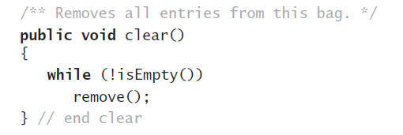
Methods That Remove Entries
The method clear
© 2016 Pearson Education, Ltd. All rights reserved.

Slide 31
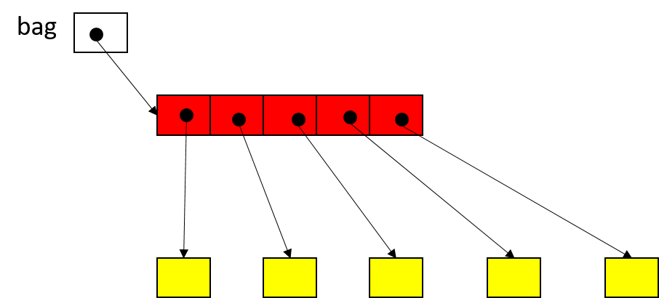
Garbage Collection in Java
bag = null
for(int i=0; i<bag.length; i++)
bag[i] = null

Slide 32
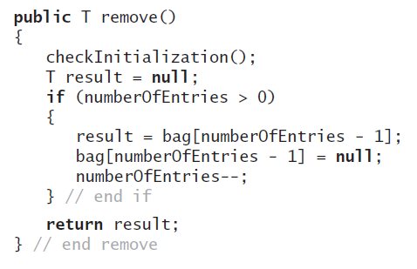
Methods That Remove Entries
The method remove
© 2016 Pearson Education, Ltd. All rights reserved.

Slide 33
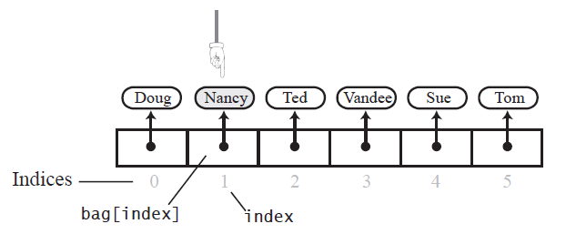
Methods That Remove Entries
The array bag after a successful search for the string “Nancy"
© 2016 Pearson Education, Ltd. All rights reserved.

Slide 34
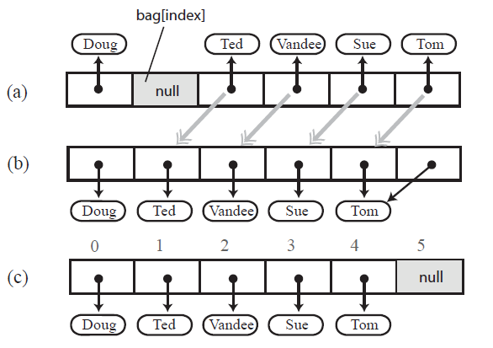
Methods That Remove Entries
(a) A gap in the array bag after setting the entry in bag[index] to null
(b-c) the array after shifting subsequent entries to avoid a gap
© 2016 Pearson Education, Ltd. All rights reserved.

Slide 35
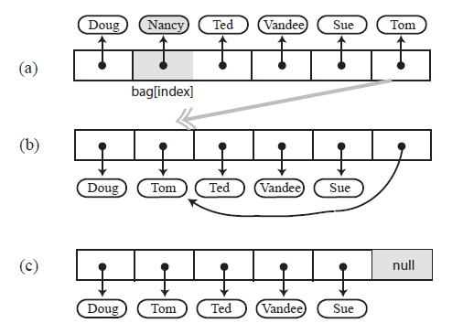
Methods That Remove Entries
Avoiding a gap in the array while removing an entry
© 2016 Pearson Education, Ltd. All rights reserved.

Slide 36
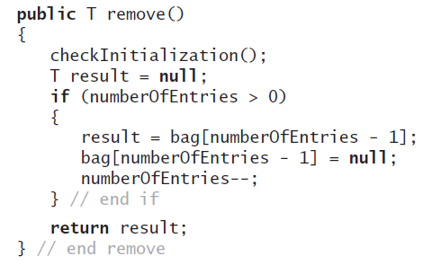
Methods That Remove Entries
New definition of remove
© 2016 Pearson Education, Ltd. All rights reserved.

Slide 37
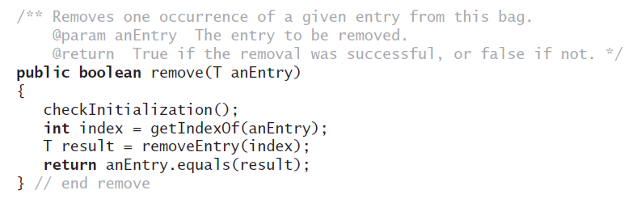
Methods That Remove Entries
The second remove method
© 2016 Pearson Education, Ltd. All rights reserved.

Slide 38
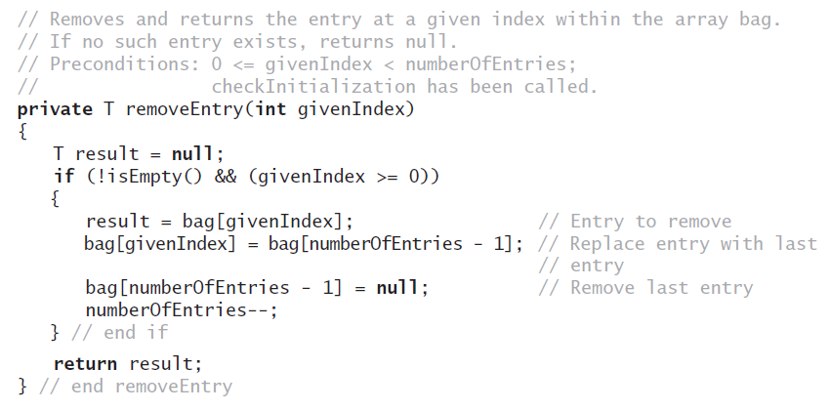
Methods That Remove Entries
The removeEntry method
© 2016 Pearson Education, Ltd. All rights reserved.

Slide 39
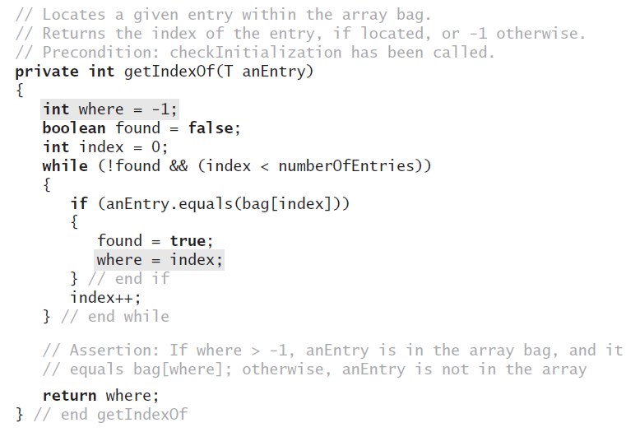
Methods That Remove Entries
Definition for the method getIndexOf
© 2016 Pearson Education, Ltd. All rights reserved.

Slide 40
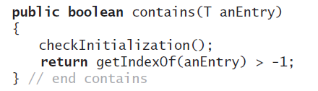
Methods That Remove Entries
Revised definition for the method contains
© 2016 Pearson Education, Ltd. All rights reserved.

Slide 41
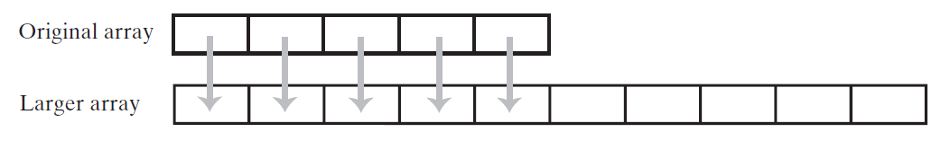
Using Array Resizing
Resizing an array copies its contents to a larger second array
© 2016 Pearson Education, Ltd. All rights reserved.

Slide 42
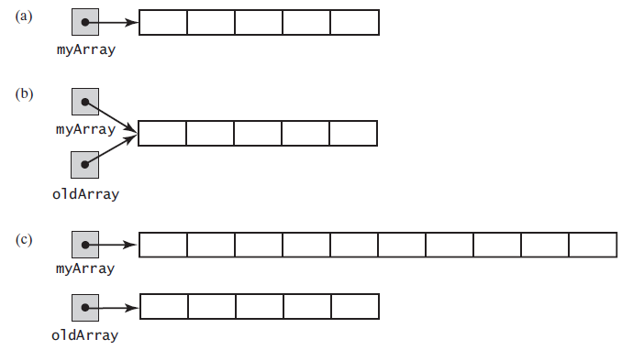
Using Array Resizing
(a) An array; (b) two references to the same array; (c) the original array variable now references a new, larger array;
© 2016 Pearson Education, Ltd. All rights reserved.

Slide 43
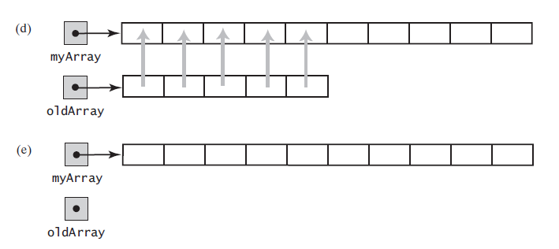
Using Array Resizing
(d) the entries in the original array are copied to the new array; (e) the original array is discarded
© 2016 Pearson Education, Ltd. All rights reserved.

Slide 44
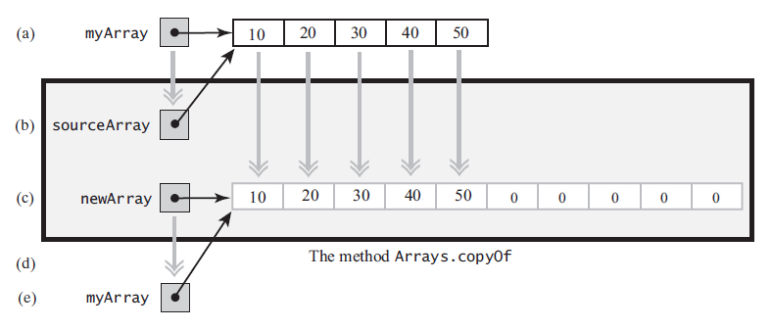
Using Array Resizing
The effect of the statement
myArray = Arrays.copyOf(myArray, 2 * myArray.length);
(a) The argument array; (b) the parameter that references the argument array; (c) a new, larger array that gets the contents of the argument array; (d) the return value that references the new array; (e) the argument variable is assigned the return value
© 2016 Pearson Education, Ltd. All rights reserved.

Slide 45
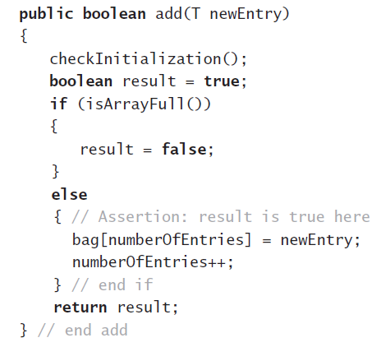
New Implementation of a Bag
Previous definition of method add
© 2016 Pearson Education, Ltd. All rights reserved.

Slide 46
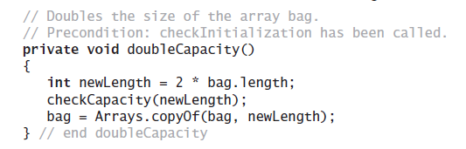
New Implementation of a Bag
The method doubleCapacity
© 2016 Pearson Education, Ltd. All rights reserved.

Slide 47
Using a Bag
A Bag is a simple ADT, but it can still be useful
See examples in text
Here is another simple one
A number of players “shout” Snap! each with a certain probability.
Add the player number to a Bag if she shouts.
Count the number of shouts in the Bag.

Slide 48
Pros and Cons of Using an Array
Adding an entry to the bag is fast
Removing an unspecified entry is fast
Removing a particular entry requires time to locate the entry
Increasing the size of the array requires time to copy its entries
© 2016 Pearson Education, Ltd. All rights reserved.

Slide 49
Problems with Array Implementation
Array has fixed size
May become full
Alternatively may have wasted space
Resizing is possible but requires time overhead

